Slide 1

Department of Computer Science and Engineering
(Cyber Security)
CS23533– Foundations of Artificial Intelligence
2026-2027
FraudShield AI — Intelligent Digital Payment Risk Assessment System — Review 2
Supervisor
Dr. S. Bhuvana
Assistant Professor (SG)
Team Members
Deepan S A (241901021)
Barathraj M (241901015)

Slide 2
Problem Statement and Motivation
Problem: classify each digital payment as LOW, MEDIUM, HIGH or CRITICAL risk from seven inputs and explain why.
Why it is hard: no single input proves fraud; the seven inputs matter in combination, and black-box scores give no reasons.
Who is affected: customers whose genuine payments are blocked, and analysts who must justify every decision.
Motivation: a transparent rule-based expert system: forward chaining over readable rules, every decision explained.

Slide 3
Objectives
# | Objective | Measurable outcome | Status
1 | Model each payment as facts from seven inputs (amount, time, device, location, login, frequency, account) | All seven inputs captured and validated for every transaction | Completed
2 | Knowledge base: fraud conditions written as predicate-logic if–then rules | Risk conditions are readable rules, kept apart from the web code | Completed
3 | Forward-chaining inference engine | Fires every matching rule and derives new facts until none apply | Completed
4 | Conflict resolution and four risk tiers | One decision per transaction: LOW, MEDIUM, HIGH or CRITICAL | Completed
5 | Explainable AI (XAI): reasons for every decision | Each result lists the rules that fired and why | Completed
6 | Web application: submit a payment, view risk and explanation | FastAPI + SQLite backend, React web interface, Windows run.bat start-up | Completed
7 | Testing, final evaluation, report and documentation | pytest and Playwright tests; final report and review deck | In progress

Slide 4
Project Progress Since Review 1
All five modules implemented: Python rule engine and API, React web interface, SQLite storage.
Forward-chaining inference with conflict resolution assigns one of four risk tiers: LOW, MEDIUM, HIGH, CRITICAL.
Explainable output added: every decision lists the rules that fired and the reason for each.
Web application built with FastAPI, Pydantic, SQLAlchemy, React, TypeScript, Vite and Tailwind CSS.
Sample transactions prepared: TXN001 (critical) and TXN002 (normal).
Windows start-up script run.bat and test suites (pytest, Playwright) written; end-to-end run in progress.
5 / 5
modules implemented
4
risk tiers
7
core risk inputs
2
sample transactions
Current status
Completed: design, rule base, inference engine, web app
In progress: end-to-end testing, final evaluation and report

Slide 5
Literature Survey
S. No. | Author(s) & Year | Paper Title | Methodology / Algorithm | Limitations
1 | C. L. Forgy (1982) | Rete: A Fast Algorithm for the Many Pattern/Many Object Pattern Match Problem | Rete network that shares condition tests between rules and stores partial matches, speeding up forward-chaining production systems | Speeds up matching only; stores partial matches in memory; offers no risk model or explanation of its own
2 | B. G. Buchanan, E. H. Shortliffe (1984) | Rule-Based Expert Systems: The MYCIN Experiments of the Stanford Heuristic Programming Project | If–then rules with certainty factors, plus an explanation of how each conclusion was reached (MYCIN) | Built for medical diagnosis; certainty factors are ad hoc; rules must be hand-written from expert knowledge
3 | R. J. Bolton, D. J. Hand (2002) | Statistical Fraud Detection: A Review | Surveys statistical methods for fraud detection, from outlier detection to supervised classification | A survey, not a working system; the scores it discusses give little readable reasoning

Slide 6
Literature Survey
S. No. | Author(s) & Year | Paper Title | Methodology / Algorithm | Limitations
4 | A. Dal Pozzolo, G. Boracchi, O. Caelen, C. Alippi, G. Bontempi (2018) | Credit Card Fraud Detection: A Realistic Modeling and a Novel Learning Strategy | Machine-learning classifiers on card transactions, handling class imbalance, delayed labels and investigator feedback | Needs a large labelled transaction history; the learned model gives an analyst no rules to read
5 | M. T. Ribeiro, S. Singh, C. Guestrin (2016) | “Why Should I Trust You?”: Explaining the Predictions of Any Classifier | LIME: explains one prediction of any classifier by fitting a simple interpretable model around it | Post-hoc and approximate; explains a black box instead of making the decision itself transparent

Slide 7
Research Gap and Project Response
1. Literature findings
Rule-based forward chaining is a proven way to reason from facts [1]; expert systems can explain their conclusions [2]; fraud detection research is mostly statistical or learned [3], [4], [6]; explanations of such models are added afterwards [5].
2. Limitations
Learned fraud models need labelled history and give no readable reasoning; classic expert systems were built for other domains and rely on ad hoc certainty factors; post-hoc explanations are only approximations.
3. Refined research gap
A compact, transparent expert system for digital payment risk: seven inputs combined by forward-chaining rules, conflicts resolved to one tier, and every decision explained.
4. Progress toward the solution
Built: rule base over seven inputs; forward-chaining engine with conflict resolution; four risk tiers; an explanation for every decision; FastAPI + React web app with SQLite storage; samples TXN001 and TXN002.

Slide 8
System Architecture / Proposed System
Web interface — React · TypeScript · Vite · Tailwind
transaction entry · risk tier · explanation view
How the components interact
The page sends each transaction as a JSON request; the API validates it with Pydantic and returns the risk tier and its explanation.
The inference engine fires every matching rule on the facts until none apply; conflict resolution then fixes the final tier.
The knowledge base is kept apart from the API and the page, so rules can be tested on their own.
Improvements over the existing system
Readable rules instead of a black-box score
Every decision names the rules that fired
Four clear tiers: LOW, MEDIUM, HIGH, CRITICAL
One run.bat starts the whole app on Windows
HTTP / JSON requests to the API
API layer — FastAPI + Pydantic (M3)
request validation · endpoints · JSON responses
Inference (M2)
forward chaining · conflict resolution
Data (M4)
SQLAlchemy · SQLite storage
Explanation (M5)
fired rules · reasons (XAI)
Knowledge base (M1)
transaction facts (7 inputs) · predicate-logic rules · risk tiers

Slide 9
DFD Diagram – Level 0
Level 0 – context diagram: the whole system as one process and the people who exchange data with it.
0
FraudShield AI
rule-based payment risk assessment
transaction details (seven inputs)
test request: sample case (e.g. TXN001)
Analyst
(user / fraud officer)
Evaluator
(reviewer / tester)
risk tier, rules fired, explanation
decision and explanation for review
Notation:
external entity
process
D
data store
data flow

Slide 10
DFD Diagram – Level 1
Level 1: process 0 broken into six processes and three data stores.
1.0
Validate Transaction
transaction record
D2
Rule Base
D1
Transaction Store
rules, facts
validated facts
records
Analyst
2.0
Fire Rules
fired /
rules
3.0
Resolve Conflicts
Evaluator
transaction data, requests
rules fired
facts /
tier
test request
resolved rule
reports
risk tier, explanation
6.0
Display Result
4.0
Assign Tier & Explain
5.0
Review & Report
D3
Decision Records
reasons,
tier
decisions /
reports
Notation:
external entity
process
D
data store
data flow

Slide 11
Methodology / Workflow Diagram
1
INPUT
2
PREPROCESSING
3
PREPROCESSING
4
DESIGN
Transaction input
Validate
Derive facts
Formulate
Seven inputs: amount, time, device trust, location, login behaviour, frequency, account activity
Pydantic schema checks every input before any rule runs
Inputs become predicates over the transaction, e.g. HighAmount(t), UntrustedDevice(t)
Knowledge base = facts + if–then rules; output = tier LOW to CRITICAL
5
IMPLEMENTATION
6
IMPLEMENTATION
7
TESTING
8
EVALUATION · OUTPUT
Infer
Resolve & score
Verify
Explain
Forward chaining fires every matching rule until no new fact appears
Conflict resolution fixes the final risk tier from the rules that fired
pytest on the rule engine; Playwright on the web flow; samples TXN001, TXN002
Tier plus fired rules in plain language, shown in the web app
Feedback loop: findings from testing and evaluation go back into steps 3–6 (facts, rules and explanation wording).

Slide 12
Tools and Technologies
Programming languages: Python for the rule engine and API; TypeScript for the web interface.
Frameworks / libraries: FastAPI, Pydantic, SQLAlchemy; React, Vite, Tailwind CSS; pytest and Playwright for testing.
Software / hardware / dataset: SQLite database; Windows 10/11 with run.bat start-up (Docker optional); sample transactions TXN001 and TXN002.
Why these tools: typed validation, a light database and a one-click start keep the system easy to run after extracting the ZIP; a symbolic rule engine needs no GPU or training data.
Python
FastAPI
SQLite
React · TypeScript
Tailwind
pytest · Playwright

Slide 13
List of Modules
Module | Technology / components | Responsibility | Status
M1 Knowledge Base | Facts schema; predicate-logic rule base | Turn the seven inputs into facts; hold the if–then risk rules and the four risk tiers | Completed
M2 Inference | Forward chaining; conflict resolution | Fire matching rules until none apply; resolve conflicts; assign LOW / MEDIUM / HIGH / CRITICAL | Completed
M3 Interface | FastAPI + Pydantic API; React · TypeScript · Vite · Tailwind UI | Validated endpoints; web pages to submit a payment and view its tier and explanation | Completed
M4 Data | SQLAlchemy · SQLite | Store transactions and decisions; samples TXN001 (critical) and TXN002 (normal) | Completed
M5 Explanation | Explainable AI (XAI) | Fired rules and a plain-language reason for every decision | Completed
Testing | pytest · Playwright | Unit tests for rules and engine; browser tests for the web flow; end-to-end run pending | In progress
Final report | README, report | Write-up of design, rules, inference method and results | In progress

Slide 14
Module Implementation – Part 1
M1
Knowledge base – the rules
M2
Inference engine – the AI
Purpose
Turns a transaction into facts and holds the risk rules.
Input → output
Seven inputs (JSON) → validated facts + rule base.
Key components
Pydantic schema validates the inputs; each input becomes a predicate over the transaction; each rule is an if–then condition over those predicates and concludes a risk level.
Design choice
Rules are kept apart from the web code, so they can be read, tested and changed on their own.
Status and tests
Completed. Checked with pytest and the two sample transactions.
Purpose
Reasons over the facts and decides the risk tier.
Input → output
Facts + rule base → fired rules, risk tier (LOW to CRITICAL), reasons.
Key components
Forward chaining: fire every rule whose conditions hold, add its conclusion as a new fact, repeat until nothing changes; conflict resolution then fixes the final tier.
Design choice
Every fired rule is recorded, so no step of the decision is hidden.
Status and tests
Completed. Core engine checked with pytest and the two sample cases.

Slide 15
Module Implementation – Part 2
Forward chaining – core loop (inference engine)
M3
Interface completed
facts ← facts_from(transaction); fired ← { }
loop:
agenda ← { r : r.if holds in facts, r ∉ fired }
if agenda is empty: break
r ← resolve_conflict(agenda)
facts ← facts ∪ r.then; fired ← fired ∪ { r }
record(r, reason(r)) # for the explanation
tier ← tier_from(facts) # LOW … CRITICAL
return tier, fired, reasons
FastAPI endpoints validate each request with Pydantic and return the tier and explanation as JSON; the React page shows the result.
M4
Data completed
SQLAlchemy models store transactions and decisions in SQLite; the sample cases TXN001 (critical) and TXN002 (normal) are included.
M5
Explanation completed
Every decision lists the rules that fired and a plain-language reason for each, so an analyst can check the tier.

Slide 16
Preliminary Results and Discussion
Sample | Scenario | Risk tier | Output shown
TXN001 | High-risk payment sample | CRITICAL | Tier, rules fired and a plain-language reason for each
TXN002 | Normal payment sample | Normal | Tier and the reasons it stayed low
Risk tiers assigned by the system
LOW
MEDIUM
Transparent by design. Every decision comes with the rules that fired and a plain-language reason.
One tier per transaction. Conflict resolution reduces all fired rules to LOW, MEDIUM, HIGH or CRITICAL.
Both ends of the scale. TXN001 is the critical sample; TXN002 is the normal one.
Numerical evaluation (rule coverage, response time, test counts) will be reported at the final review, once the end-to-end run is complete.
HIGH
CRITICAL
least risk → most risk

Slide 17
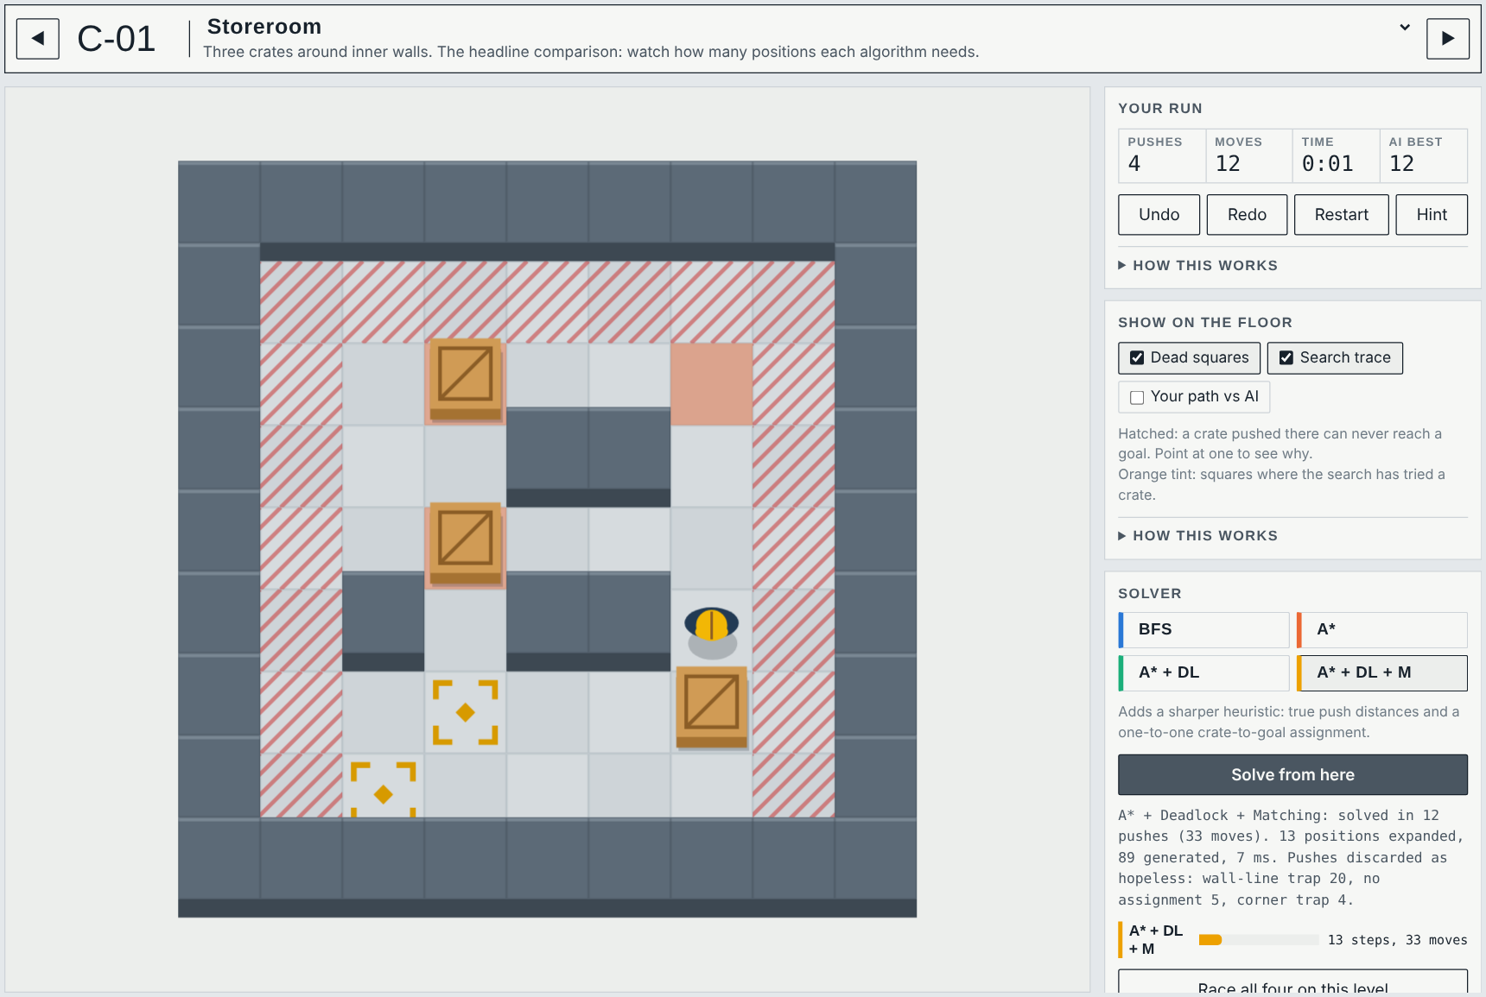
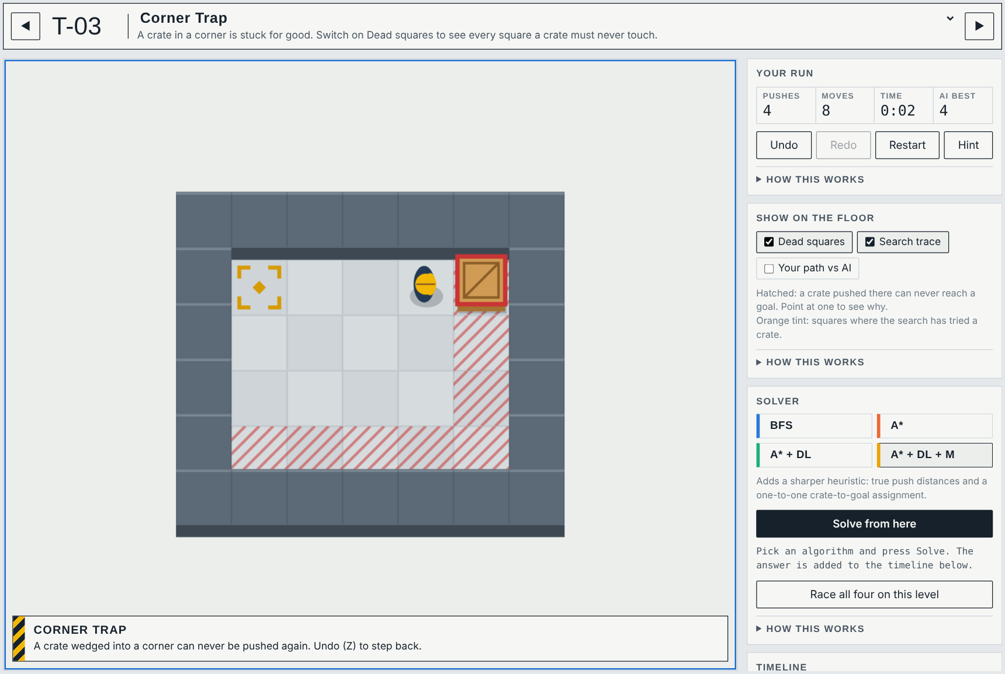
User Interface / Implementation Screenshots
Play + solver – A* + Deadlock + Matching solves Storeroom in 12 pushes after expanding 13 positions; hatched squares are dead squares, the timeline replays the answer.
Deadlock coach – the moment a push makes the level unwinnable, the rule is named (here: corner trap) and the crate is outlined; Undo steps back.

Slide 18
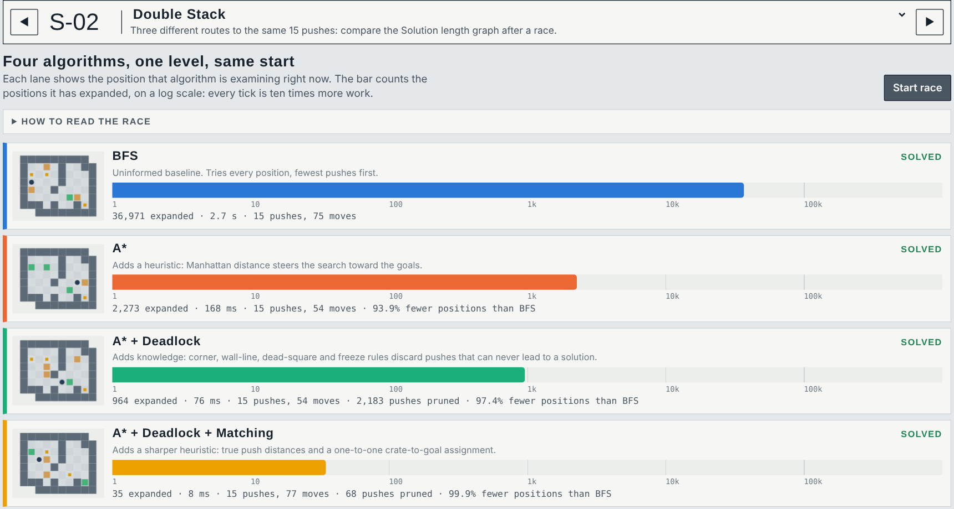
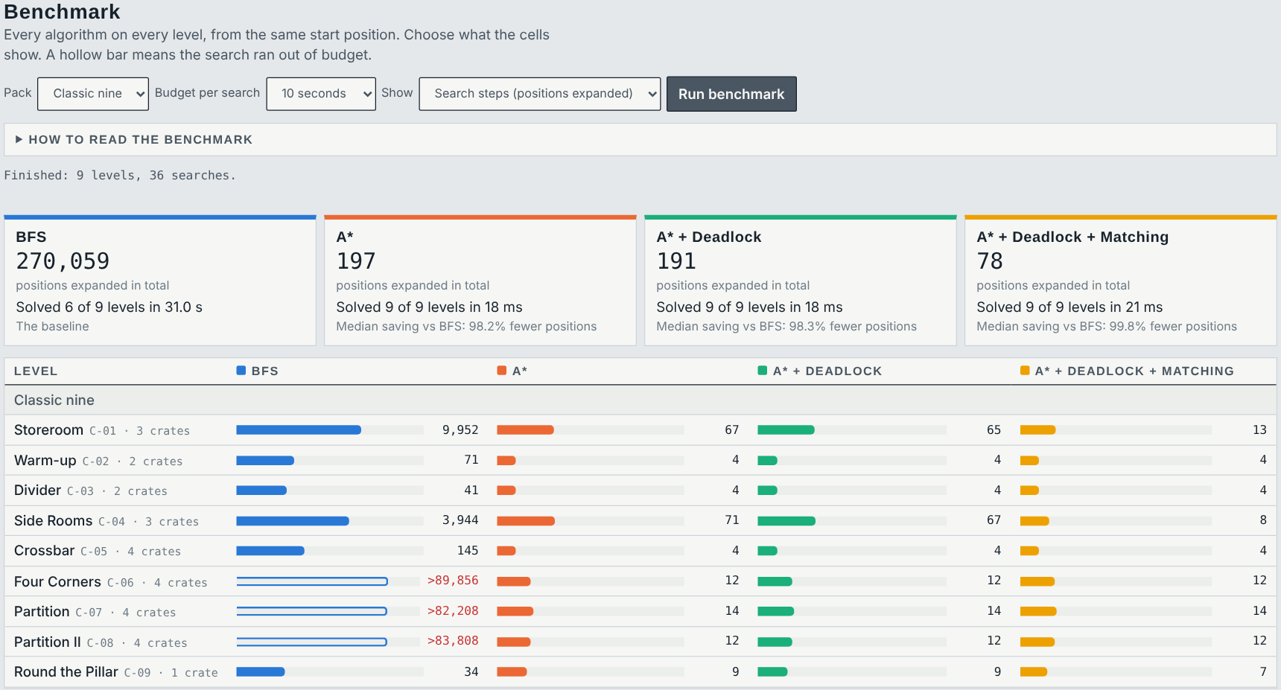
User Interface / Implementation Screenshots
Race – all four algorithms on Double Stack at once: 36,971 vs 2,273 vs 964 vs 35 positions expanded, the same 15 pushes.
Benchmark lab – every algorithm on every level of a pack with totals and median savings; copy as CSV or Markdown.

Slide 19
Challenges Faced and Solutions
Challenge faced | Solution adopted
Several rules can fire on one transaction and point to different tiers | Conflict resolution fixes one tier; every fired rule is still kept for the explanation
One input alone is weak evidence of fraud; the seven inputs interact | Rules combine inputs with predicate logic instead of single-field limits
A bare risk score is hard to trust without reasons | Explainable AI: each decision lists the fired rules and a plain-language reason
Missing or malformed inputs could reach the rules | Pydantic validation rejects bad requests before inference runs
The app must start on Windows 10/11 from any extracted folder | run.bat start-up designed to work after ZIP extraction in any directory
Web layers could not be executed in the offline build environment | Core engine tested on its own; web layers marked “not executed” until run on Windows; no false pass claims
Need clear test cases at both ends of the risk scale | Two samples: TXN001 (critical) and TXN002 (normal)
Remaining issues: a rule base knows only the patterns written into it; thresholds and tier boundaries need tuning; browser (Playwright) and end-to-end runs are still pending.

Slide 20
Work Plan Until Final Review
Week 1
Week 2
Week 3
Week 4
End-to-end testing
• Run the full app on Windows 10/11 via run.bat
• Run the Playwright browser tests
• Fix any start-up or API issues
Rule refinement
• Review rule coverage of the seven inputs
• Tune thresholds and tier boundaries
• Keep every pytest test green
Documentation
• Final report: formulation, rules, inference, results
• Screenshots and figures
• README and code comments
Final testing & presentation
• Test the extracted ZIP in a clean folder
• Final slides and demo rehearsal
• Submit report and code
At the final review: working system, test results, report, presentation and live demo.

Slide 21
References
[1] C. L. Forgy, “Rete: A fast algorithm for the many pattern/many object pattern match problem,” Artificial Intelligence, vol. 19, no. 1, pp. 17–37, 1982.
[2] B. G. Buchanan and E. H. Shortliffe, Eds., Rule-Based Expert Systems: The MYCIN Experiments of the Stanford Heuristic Programming Project. Reading, MA, USA: Addison-Wesley, 1984.
[3] R. J. Bolton and D. J. Hand, “Statistical fraud detection: A review,” Statistical Science, vol. 17, no. 3, pp. 235–255, 2002.
[4] A. Dal Pozzolo, G. Boracchi, O. Caelen, C. Alippi and G. Bontempi, “Credit card fraud detection: A realistic modeling and a novel learning strategy,” IEEE Trans. Neural Networks and Learning Systems, vol. 29, no. 8, pp. 3784–3797, 2018.
[5] M. T. Ribeiro, S. Singh and C. Guestrin, ‘Why should I trust you?’: Explaining the predictions of any classifier,” in Proc. 22nd ACM SIGKDD Int. Conf. Knowledge Discovery and Data Mining, 2016, pp. 1135–1144.
[6] C. Phua, V. Lee, K. Smith and R. Gayler, “A comprehensive survey of data mining-based fraud detection research,” arXiv:1009.6119, 2010.
[7] S. Russell and P. Norvig, Artificial Intelligence: A Modern Approach, 4th ed. Pearson, 2020.
[8] FastAPI documentation, https://fastapi.tiangolo.com
[9] Deepan S A and Barathraj M, “FraudShield AI — Intelligent Digital Payment Risk Assessment System” (source code), FraudShield_AI.zip, 2026.

Slide 22
Thank You
Demo: run.bat in the extracted FraudShield_AI.zip (Windows 10/11)
Source code: FraudShield_AI.zip, submitted with the report

